Slide 1

IMPLEMENTING ANGULAR SERVICES IN WEB APPLICATIONS
-PRESENTED BY
K.RAKSHITHA
22H51A0529
CSE-D

Slide 2
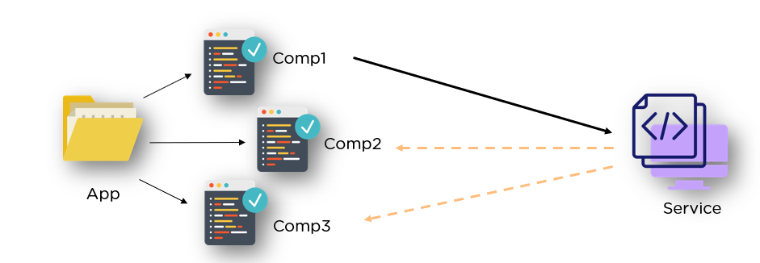
Introduction to Angular Services
Angular services are reusable components that encapsulate business logic.
They help in sharing data and functionality across different components in an Angular application.
By promoting modularity, services enhance maintainability and testability of the codebase.

Slide 3
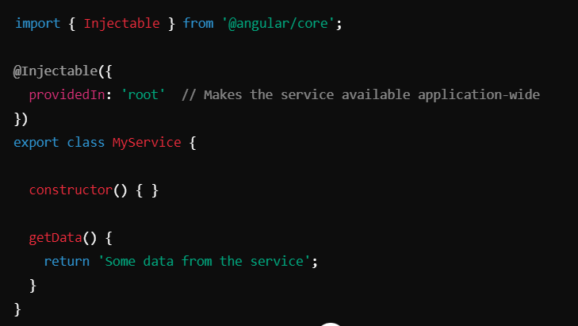
Creating a Basic Angular Service
To create a service, you can use the Angular CLI command `ng generate service service-name`.
This will create two files:
my-service.service.ts – contains the logic for your service.
my-service.service.spec.ts – contains unit tests for the service.
A service is typically defined as a TypeScript class with the `@Injectable()` decorator.
This decorator enables the service to be injected into components or other services.

Slide 4
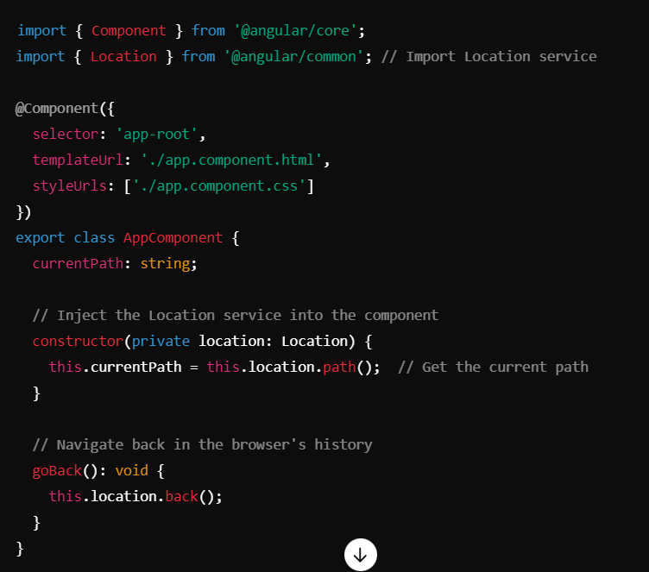
Location services
The $location service has methods which return information about the location of the current web page.
Other $location methods :
$location.protocol(): Returns the protocol of the URL (e.g., http or https).
$location.host(): Returns the host (e.g., localhost).
$location.port(): Returns the port number (e.g., 8000).

Slide 5
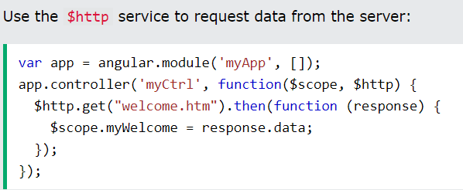
Using HTTP Services for API Calls
Angular provides the `HttpClient` service to perform HTTP requests to external APIs.
You can define methods in your service to handle GET, POST, PUT, and DELETE requests.
Utilizing HTTP services allows for clean separation of data handling from UI components.

Slide 6
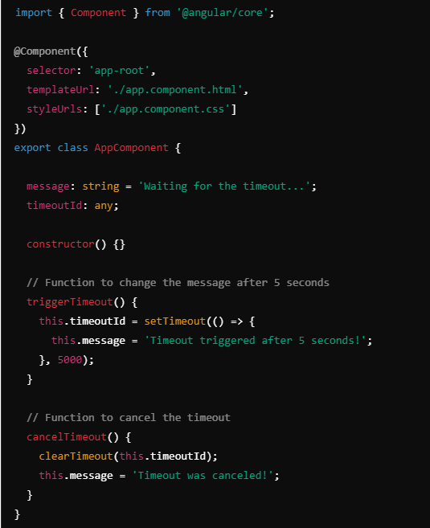
Timeout sevices
In Angular, the $timeout service was used in AngularJS to execute code after a delay.
setTimeout(): A native JavaScript function used to delay the execution of a callback function.
triggerTimeout(): A function that changes the message after a delay of 3 seconds.
Template: Displays a button to start the timeout, and the message updates after the delay.
clearTimeout(): Cancel a timeout if needed.

Slide 7
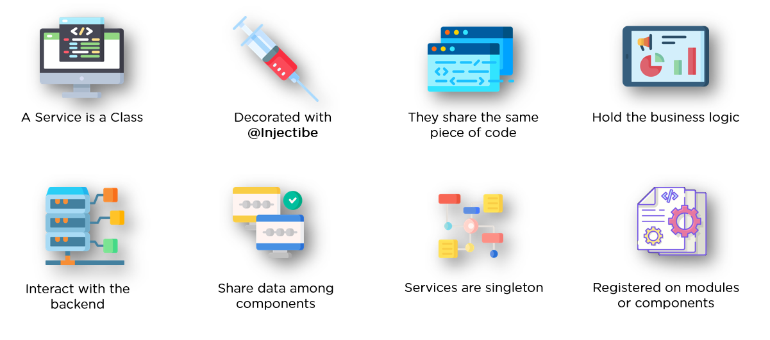
Registering Services in Angular
Services can be registered at the root level or in specific modules using the `providers` array.
Registering a service at the root level makes it a singleton, shared across the application.
Local registration allows for multiple instances of the service, scoped to a particular module.

Slide 8
Observables and Async Data Handling
Angular services often use RxJS Observables to manage asynchronous data streams.
Observables allow for reactive programming, handling data changes and updates efficiently.
Components can subscribe to these observables to receive real-time data updates.

Slide 9

Testing Angular services
Angular services can be tested using Jasmine and Karma for unit testing.
Mocking dependencies allows for isolated testing of service logic without external factors.
Comprehensive tests ensure that services function correctly under various scenarios.

Slide 10
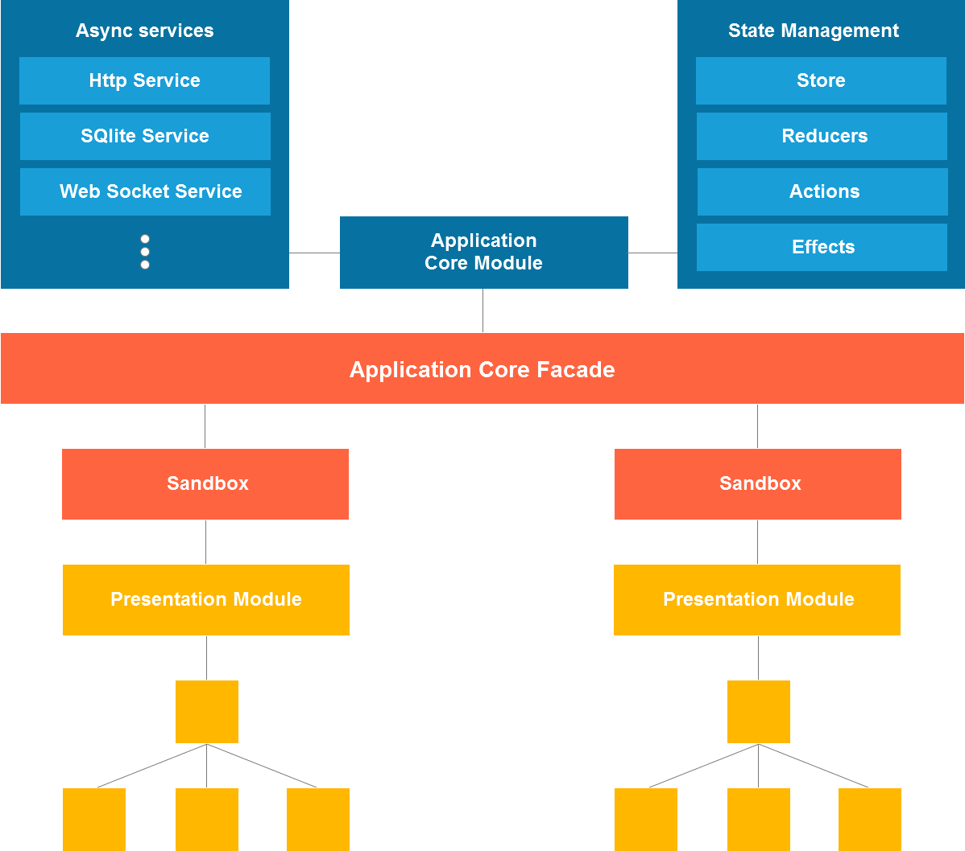
Conclusion
Implementing services in Angular applications is crucial for effective architecture.
They facilitate code reusability, maintainability, and clean separation of concerns.
Mastering Angular services significantly enhances the development experience and application performance.

Slide 11


